Slide 1
NCRMP Hawaiian Islands Report Card: Benthic Indicators

Slide 2
HAWAIIAN ARCHIPELAGO
CORAL COVER
Island | CORAL | Score | Grade
French Frigate | 20.35 | 70.35 | C
Hawaii | 13.92 | 63.92 | D
Kahoolawe | 16.93 | 66.93 | D
Kauai | 17.44 | 67.44 | D
Kure | 4.90 | 29.39 | F
Lanai | 13.06 | 63.06 | D
Lisianski | 17.04 | 67.04 | D
Maui | 26.30 | 76.30 | C
Molokai | 8.61 | 51.68 | F
Niihau | 2.40 | 14.43 | F
Oahu | 1.09 | 6.54 | F
Pearl & Hermes | 2.39 | 14.35 | F
CORAL | Grade | Score
> = 40 | A | 90 - < 100
40 - < 30 | B | 80 - < 90
30 - < 20 | C | 70 - < 80
20 - < 10 | D | 60 - < 70
< 10 | F | < 60

Slide 3
HAWAIIAN ARCHIPELAGO
CCA COVER
Island | CCA | Score | Grade
French Frigate | 5.37 | 70.73 | C
Hawaii | 6.91 | 73.81 | C
Kahoolawe | 2.44 | 61.46 | F
Kauai | 3.96 | 66.53 | D
Kure | 7.32 | 74.65 | C
Lanai | 1.35 | 40.43 | F
Lisianski | 7.46 | 74.93 | C
Maui | 3.15 | 63.85 | F
Molokai | 2.63 | 62.09 | F
Niihau | 1.67 | 50.05 | F
Oahu | 3.13 | 63.77 | F
Pearl & Hermes | 11.95 | 81.95 | B
CCA | Grade | Score
> = 20 | A | 90 - < 100
20 - < 10 | B | 80 - < 90
10 - < 5 | C | 70 - < 80
5 - < 2 | D | 60 - < 70
< 2 | F | < 60

Slide 4
HAWAIIAN ARCHIPELAGO
MACROALGAL COVER
Island | MALG | Score | Grade
French Frigate | 7.87 | 84.27 | B
Hawaii | 9.89 | 80.22 | B
Kahoolawe | 6.51 | 86.97 | B
Kauai | 6.97 | 86.06 | B
Kure | 13.53 | 76.47 | C
Lanai | 2.66 | 99.36 | A
Lisianski | 17.78 | 72.22 | C
Maui | 5.77 | 88.46 | B
Molokai | 4.09 | 93.63 | A
Niihau | 5.54 | 88.92 | B
Oahu | 14.88 | 75.12 | C
Pearl & Hermes | 25.95 | 64.05 | D
MALG | Grade | Score
< = 5 | A | 90 - < 100
5 - < 10 | B | 80 - < 90
10 - < 20 | C | 70 - < 80
20 - < 30 | D | 60 - < 70
30 - < 40 | F | < 60

Slide 5
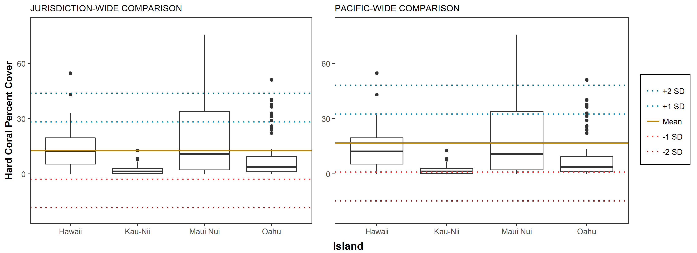
MAIN HAWAIIAN ISLANDS
CORAL COVER

Slide 6
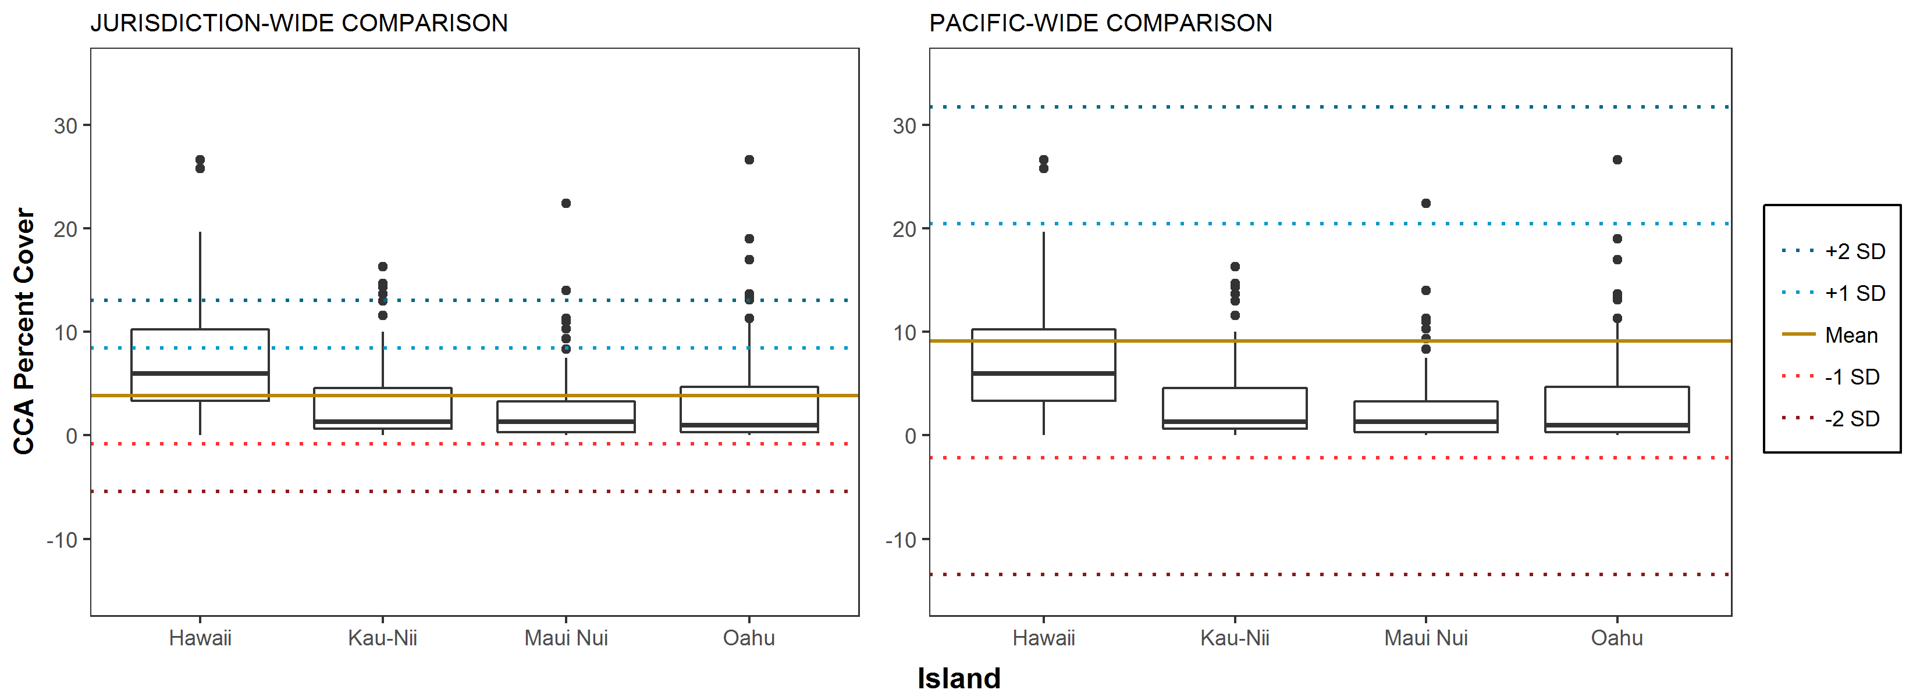
MAIN HAWAIIAN ISLANDS
CCA COVER

Slide 7
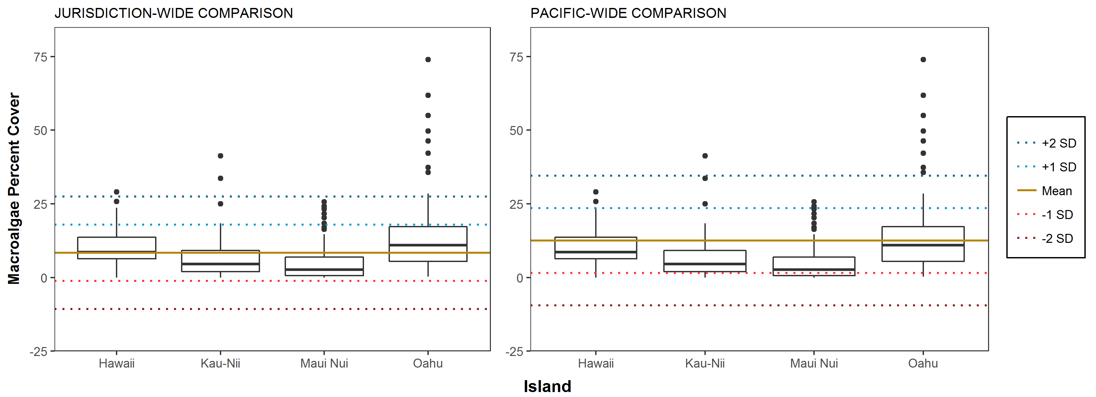
MAIN HAWAIIAN ISLANDS
MACROALGAL COVER

Slide 8
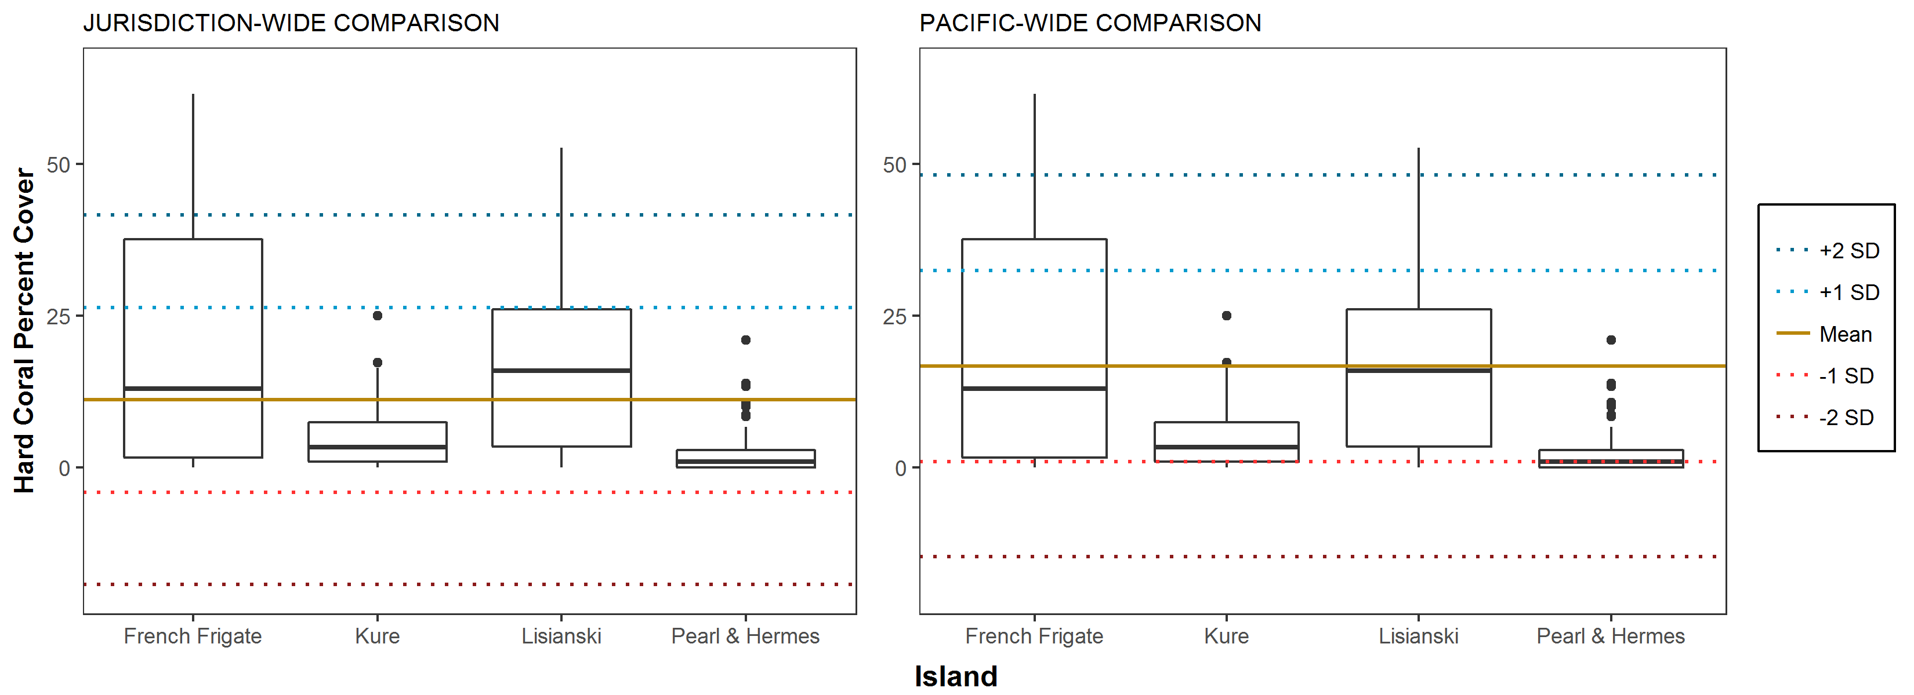
NORTHWESTERN HAWAIIAN ISLANDS
CORAL COVER

Slide 9
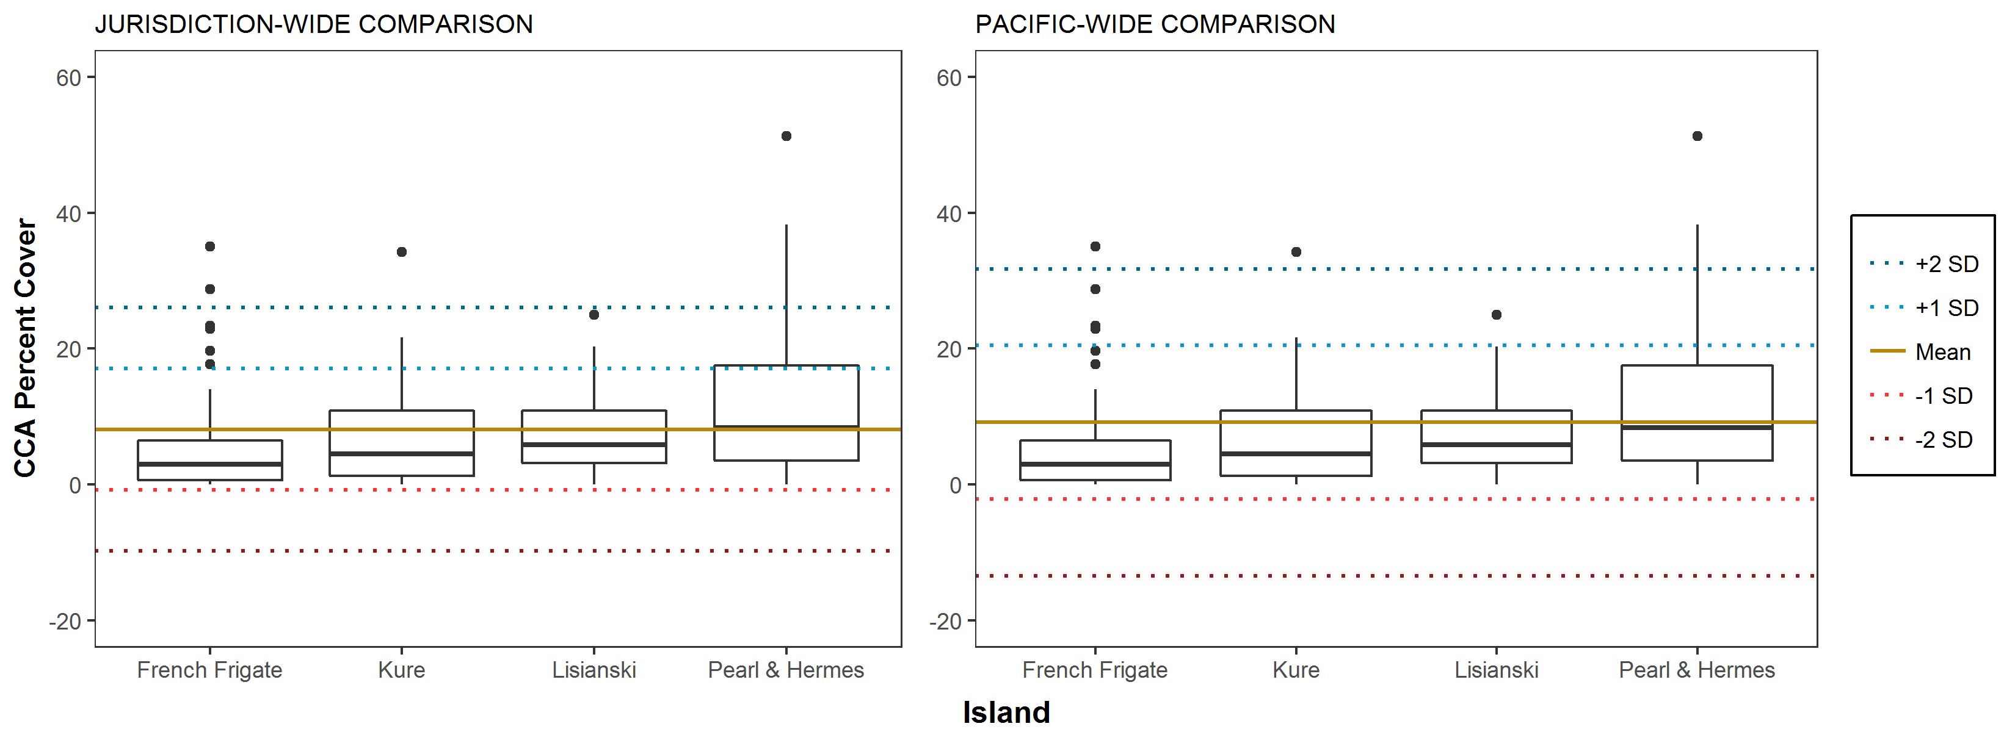
NORTHWESTERN HAWAIIAN ISLANDS
CCA COVER

Slide 10
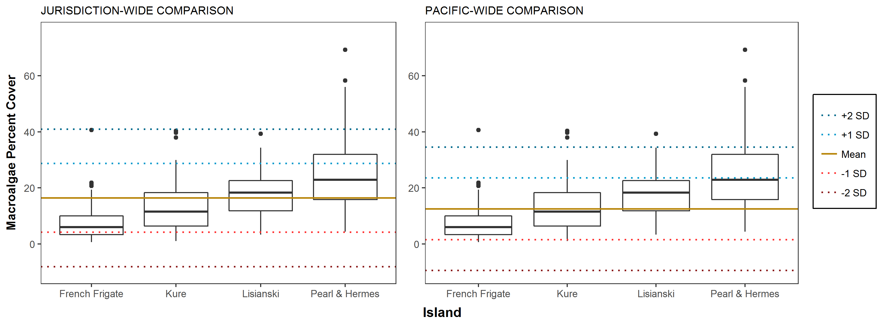
NORTHWESTERN HAWAIIAN ISLANDS
MACROALGAL COVER

